Slide 1
DOG’S BREED CLASSIFICATION USING DEEP LEARNING
Ashish Kumar(170280015)
Ashish Kumar(170280016)
Ashish Maurya(170280539)

Slide 2
Problem statement
Our goal was to classify breed of dogs using training and test data from the dataset.
The problem of image classification goes like this: Given set of images that are labelled and we are asked to classify these categories.

Slide 3
Solution-
Import Datasets.
Read Images of Dogs.
Preprocessing.
Train your Model.
Create a CNN to classify Dog’s Breed.
6. Test Your Model.

Slide 4
STEP 1. IMPORT DATASETS
We have used Pandas library to import the dataset.
Example:- df_l=pd.read_csv(labels_path)

Slide 5
STEP 2. READ IMAGES
To read the images we have used the Glob library.
Example:- ids=glob(train_path)

Slide 6
Step 3. PREPROCESSING
Data Preprocessing is a technique that is used to convert the raw data into a clean data set. In other words, whenever the data is gathered from different sources it is collected in raw format which is not feasible for the analysis.

Slide 7
Step 4. TRAIN THE MODEL
To train the model we have used train_test_split module of Sklearn Library.
Example:-
(train_x,valid_x)=train_test_split(ids,test_size=0.2,random_state=42)

Slide 8
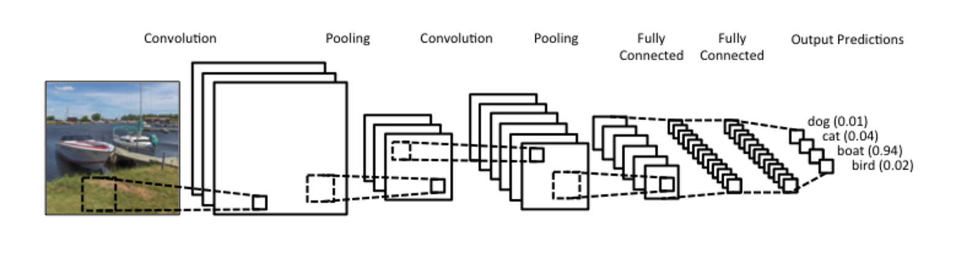
Step 5. CREATE A CNN MODEL
Example:-
backbone = MobileNetV2(input_tensor=inputs, include_top=False, weights="imagenet")

Slide 9
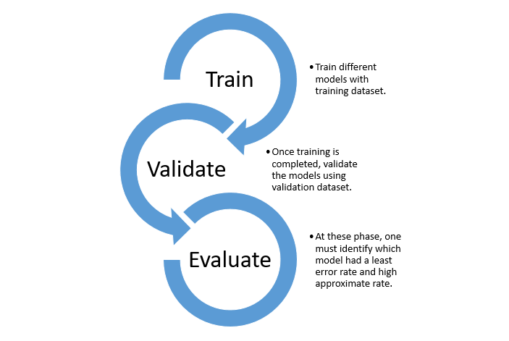
Step 6. Testing
The Model(model.h5) Which have been Trained that will be used for testing.

Slide 10
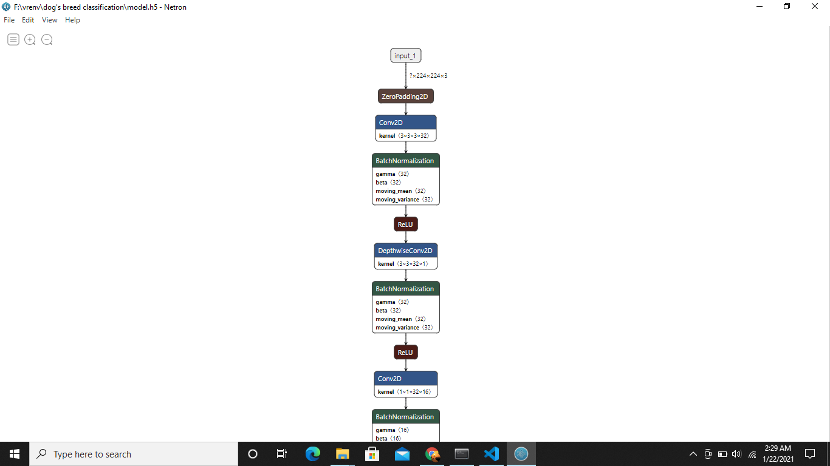
DOG’S BREED CLASSIFICATION MODEL:-

Slide 11
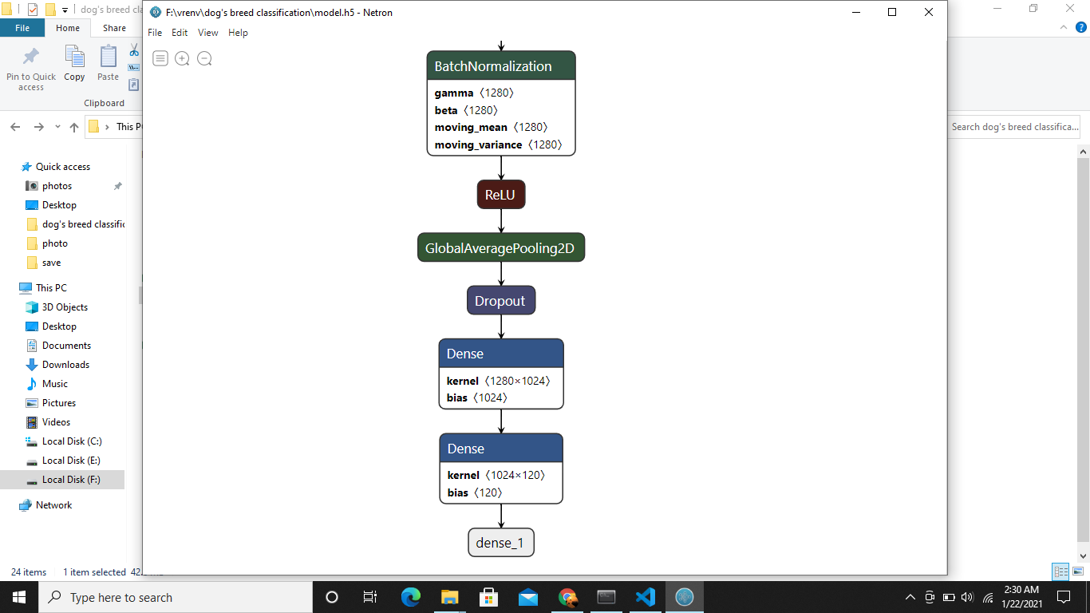

Slide 12
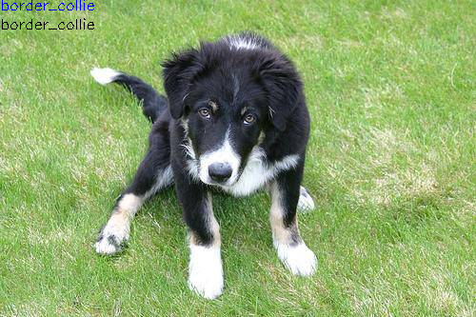
OUTPUT

Slide 13
AT LAST:-
THANK
YOU

